Slide 1
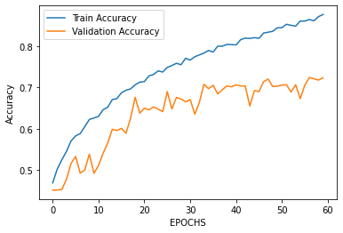
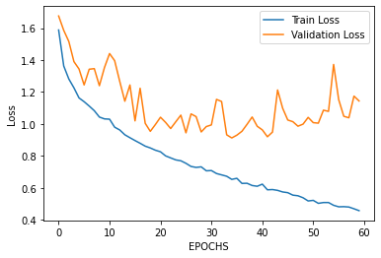
Fig. 1: Optimized GoogLeNet Model Accuracy after 60 Epochs
An improved version of GoogLeNet that can accurately detect vehicles in complex traffic scenes and has potential for implementation in various fields.
Results
Introduction
Our optimized model achieves 72.37% accuracy after 60 rounds of training on a vehicle dataset, with good performance in classification and loss reduction. Compared to top-performing models, our approach shows promise for vehicle detection and performs well on other datasets like CIFAR-10 and MNIST.
This paper presents an optimized GoogLeNet model for accurate vehicle detection in complex traffic scenes. The study showcases the model's high accuracy and optimal loss reduction, and its potential for implementation in various fields
Methods
Vehicle Detection using Optimized GoogleNet
Fig. 2: Optimized GoogLeNet Model Loss after 60 Epochs
Fig.3: Optimized GoogeLeNet Model
Conclusion
the optimized GoogLeNet model demonstrates good performance in accurately detecting vehicles in complex traffic scenes, providing promising results for real-world applications and future research in the field of image classification.
Sepehr Maleki, Habib Izadkhah

